Slide 1
Adapter

Slide 2
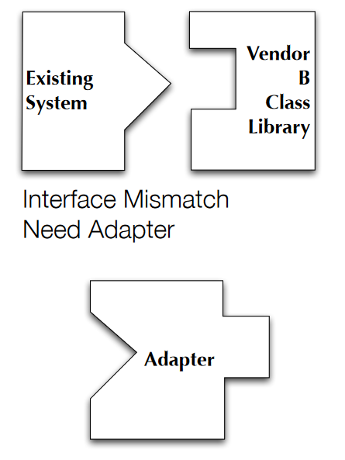
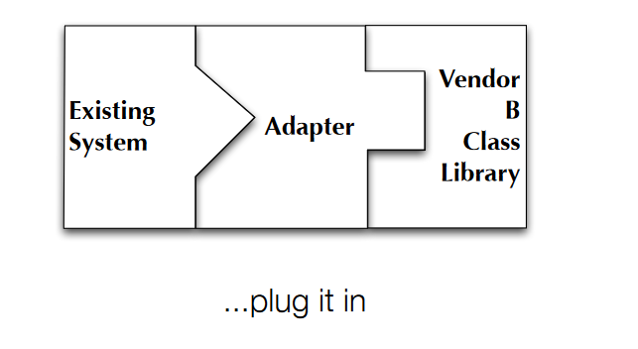
https://www.cs.colorado.edu/~kena/classes/6448/f07/lectures/23/23-Adapter.pdf

Slide 3
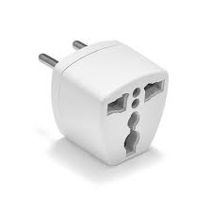
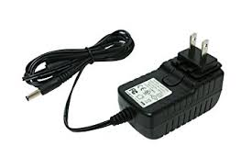
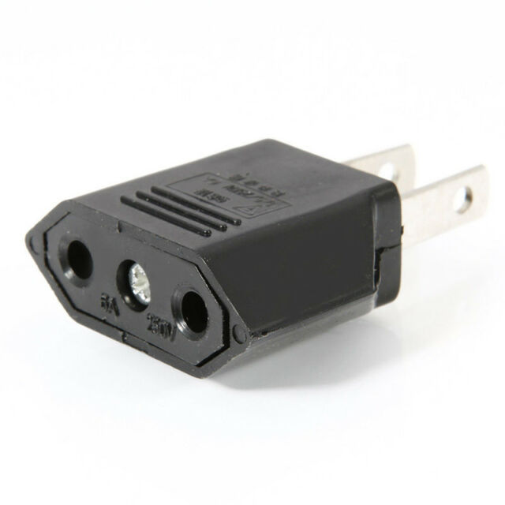
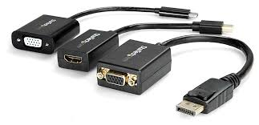
Real world examples
Connects two different pieces of equipment that cannot be connected directly.
It gets the flow from the equipment and provides it to the other equipment in the form it wants, which otherwise, is impossible to get due to their incompatible interfaces.

Slide 4
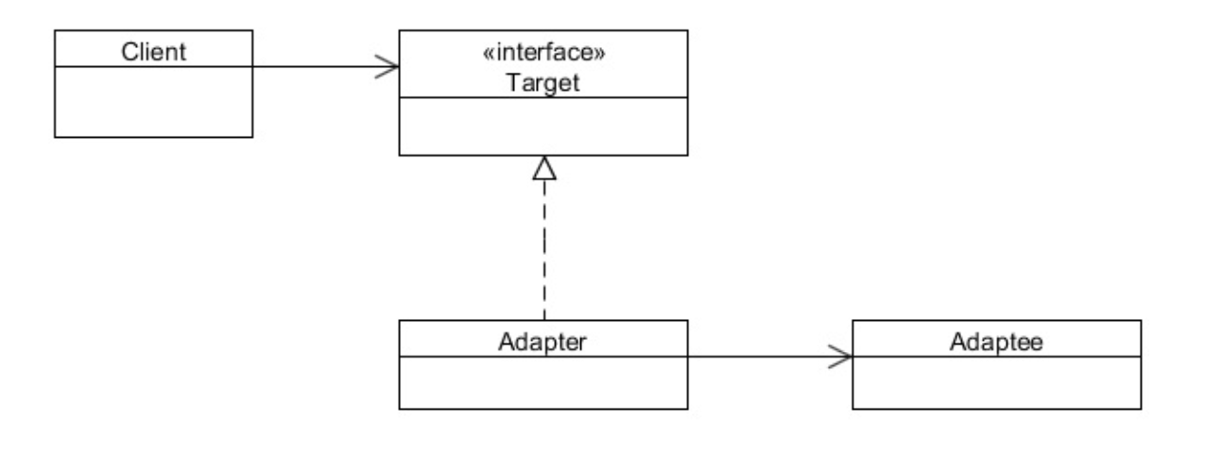

Slide 5
Demonstration

